Slide 1

Enhancing Images and Captions
An Integrated Approach
This research explores the challenge of developing an integrated system that can effectively enhance image quality while generating accurate and contextually relevant captions in real-time.
Submitted by :-
Under the guidance of :-
Aparna Dash - 2101020364
Adity Singh - 2101020248
Sourav Jyoti Dhal - 2101020260
Satyajit Patnaik - 2101020365
Dr. Ashish Ranjan
Assistant Professor,
C. V. Raman Global University, Bhubaneswar

Slide 2
CONTENTS :-
Problem Statement
Problem Specification
Introduction
Literarture Survey
Dataset Description
Proposed Solution with Block Diagram
Results and Discussion

Slide 3
Problem Statement :-
Given a set of low-resolution satellite images, denoted with {I1, I2, ..., In}, where n is the number of images.
The problem is generating a simple quantitative captioning for the images using ML models.
I1
I2
I3
I4

Slide 4
Problem Specification :-
Problem Overview:
Objective: Develop a system that can transform remote sensing images into meaningful, accurate, and quantitative textual descriptions.
Input: Satellite or aerial remote sensing images that capture various geographical, environmental, or human-made features.
Output: Quantitative, detailed textual descriptions that describe the scene in terms of measurable factors like area, distances, land use classification, and other relevant parameters.

Slide 5
Introduction :-
-
-
-
-
The task of transforming remote sensing images into quantitative textual descriptions holds significant importance for applications like urban planning, environmental monitoring, and disaster management.
In this study, we focus on enhancing the quality of remote sensing images from a specific subset of the UCM Land Use Dataset, which includes Aeroplanes, Buildings, Denseresidential, Harbor, Intersection, Mediumresidential, Mobilehomepark, Parkinglot, Sparseresidential, and Storage tanks.
The goal is to generate detailed, accurate textual descriptions that capture the spatial distribution, object counts, area coverage, and other measurable characteristics of each land use type.
By leveraging deep learning models and advanced image processing techniques, the system aims to bridge the gap between raw visual data and meaningful, interpretable quantitative insights, providing valuable information for geospatial analysis and decision-making.

Slide 6
Literature Survey :-
Sl. No | Paper Name | Datasets Used | Model Used | Result | Description
1 | Exploring Multi-Level Attention and Semantic Relationship for Remote Sensing Image Captioning | 1.UCM-Captions Dataset 2.Sydney-Captions Dataset 3.RSICD Dataset | 1.Multi-level attention module 2.Multi-label classification network 3.Graph Convolutional Network (GCN) | The proposed method significantly outperformed existing image captioning techniques, demonstrating its effectiveness in generating accurate and meaningful descriptions for remote sensing images. Performance was evaluated using metrics such as BLEU, ROUGE_L, METEOR, and CIDEr, indicating that the new approach is superior to older methods in this domain | It introduces a comprehensive framework that leverages advanced attention mechanisms and graph-based learning to improve the quality of image captions generated for remote sensing images, addressing key challenges in the field.
2 | Vision-Enhanced and Consensus-Aware Transformer for Image Captioning | 1. MSCOCO Dataset 2. Flickr30K Dataset | 1. Vision-enhanced and Consensus-aware Transformer (VCT) | The proposed Vision-Enhanced Captioning Transformer (VCT) model significantly outperforms existing state-of-the-art models across various metrics, including B-1, B-4, M, R, and S. Notably, VCT excels in generating contextually relevant captions. Overall, the results validate VCT's effectiveness in image captioning tasks, both in offline and online evaluations | Vision-Enhanced and Consensus-Aware Transformer (VCT), a novel model designed to improve image captioning by leveraging external knowledge and enhancing the interaction between visual and textual information. The VCT model employs a memory-based attention mechanism to capture intrinsic relationships within images, allowing it to generate more accurate and contextually relevant captions.
3 | Adaptive Semantic-Enhanced Transformer for Image Captioning | 1. MSCOCO Dataset 2. Flickr30K Dataset | 1. AS-Transformer 2. AoANet 3. Visual Object Relation Network (VORN) 4. Image Captioning Through Image Transformer (ICTIT) | The AS-Transformer model, particularly with the VINVL module, outperforms all comparative models in the experiments conducted on both the MSCOCO and Flickr30K datasets. This result highlights the effectiveness and generalization of the proposed method across different datasets | The paper presents a novel approach to image captioning using an advanced model called AS-Transformer, which incorporates a stronger encoder-decoder architecture enhanced by the VINVL module. The proposed method aims to improve the accuracy of semantic word generation in image captions by leveraging rich visual features extracted from images.
4 | Self-Enhanced Attention for Image Captioning | 1. COCO dataset (Common Objects in Context) | 1. Self-Enhanced Attention (SEA) | The Self-Enhanced Attention (SEA) mechanism significantly improved the performance of the image captioning model addresses the challenges of feature differentiation in image captioning tasks, leading to superior performance compared to existing methods. | The paper presents Self-Enhanced Attention (SEA), a new attention mechanism designed to improve image captioning by better emphasizing important features in complex visual data. SEA enhances the attention weight matrix to focus on key features, leading to improved results in image captioning tasks.
5 | High – order interaction learning for image captioning | 1. MSCOCO Dataset | 1. Interactive Refining Network 2. Interactive Fusion Network | The proposed high-order interaction learning method for image captioning demonstrates competitive performance on the MSCOCO dataset, outperforming state-of-the-art methods. Additionally, the interactive refining and fusion networks significantly improve feature representation and sentence generation by effectively integrating object relationships and language context during both encoding and decoding stages | "High-Order Interaction Learning for Image Captioning" focuses on enhancing the process of generating descriptive captions for images by leveraging high-order interactions among objects and their relationships. This paper contributes to the field of image captioning by addressing the limitations of previous methods and providing a framework that captures the intricate relationships between objects and their contexts.

Slide 7
Datasets Description :-
Sl. No | Dataset Name | No. of samples | Training, Testing and validation % | Description
1. | UCM-captions Dataset | 2,100 images with 10,500 descriptions. | 80% (1680) images are used for training, 10% (210) images for validation and 10% (210) images are used for test | Extends the UCMerced LandUse dataset [39] by adding detailed manual descriptions for each image.
2. | Sydney-captions Dataset | 613 images with 3065 descriptions | 497 images are used for training, 58 images are used for validation and another 58 images are used for test. | Based on the Sydney scene classification dataset.Contains 613 images classified into 7 scene categories, each image is 500x500 pixels with a resolution of 0.5m.
3. | RSICD Dataset | 10,921 images with 24,333 sentences | 8,734 (80%) images are used for training, 1094 images are used for validation and another 1,093 images are used for test. | Contains 10,921 images with low inter-class difference and high intra-class diversity, each image is 224x224 pixels with varying resolutions.
4. | MSCOCO | total of 330,000 images | 118,000 images for training, 5,000 images for validation, and 5,000 images for testing | This dataset is widely used in image captioning tasks due to its rich annotations and diverse content.
5. | Flickr30K | 31,783 images, which are accompanied by 158,915 crowd-sourced descriptions | 29,783 images for training, 1,000 images for validation, and 1,000 images for testing. | This dataset is known for its variety of scenes and objects, making it suitable for training models in image captioning tasks.
6. | COCO dataset | 100000 images and 250000 image annotations. | A total of 113,287 images for training, along with 5,000 images for validation and another 5,000 images for testing. | Publicly image dataset covers 90 different categories of objects, including people, animals, vehicles, furniture, food, and more.

Slide 8
Proposed Solution :-
Objective:
Our solution aims to enhance an image and generate image captions that not only describe the scene but also provide approximate quantitative information about the objects within the image.
This can be highly useful in various scenarios, such as estimating the number of buildings in a dense residential area or identifying the quantity of vehicles in a parking lot, improving scene understanding.
Image Enhancement:
The raw images from the UCM dataset are first enhanced to improve their clarity, ensuring that finer details are visible and can be accurately processed. This step helps with better object identification, leading to more accurate captioning.

Slide 9
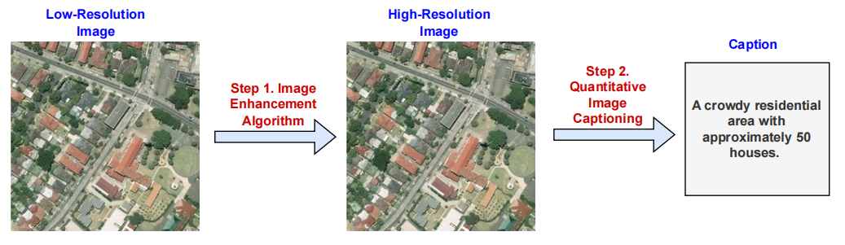
Workflow :-
ESPCN (Efficient Sub-Pixel CNN)

Slide 10
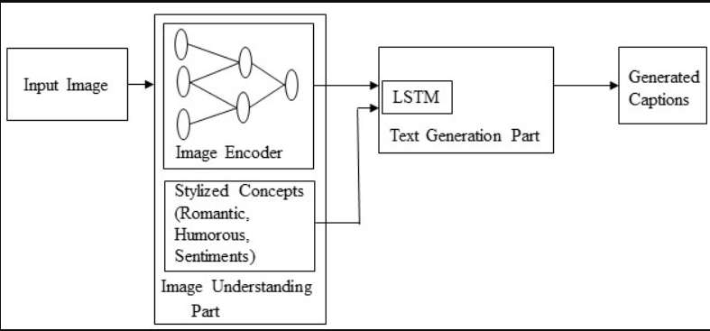
Block Diagram :-
Low resolution image to high resolution image using ESPCN.

Slide 11
Result and Discussion :-
In the results, the image enhancement technique, ESPCN (Efficient Sub-Pixel CNN), significantly improved the clarity of images from the UCM dataset.
This made objects more distinguishable, enabling better performance in the subsequent feature extraction and object detection stages. Enhanced images resulted in more accurate object detection and, consequently, more detailed captions, especially in complex scenes like dense residential areas.
The system effectively generated captions that included approximate object counts, providing useful quantitative descriptions.
These results demonstrate the system’s potential to offer a more detailed understanding of image content compared to traditional captioning methods.

Slide 12

Thank You

